Slide 1
CND212: Digital Testing and Verification

Slide 2
Coverage Driven Verification (CDV)
CDV is one of the main critical criteria for Judging the effectiveness of applied verification methodology and helps us identify what “Hasn’t been tested.”
Classified into two main types:
1. Code coverage
2. Functional coverage.
Both types of coverage metrics are essential for assessing the completeness and quality of the verification.

Slide 3
Code Coverage
Code coverage is a completion metric that indicates how much of the code of the Design Under Test (DUT) has been executed.
It does not indicate that the code is correct.
Types of RTL code coverage:
Statement coverage
Conditional coverage
Branch coverage
Path coverage
Toggle coverage
FSM coverage

Slide 4
Code Coverage: Statement coverage
Measures the percentage of code statements that have been executed during the simulation.
From N lines of code and according to the applied stimulus how many statements (lines) are covered in the simulation.
Line coverage includes only the executable statements.
Statements which are not executable like module, end module, comments, timescale etc are not covered.

Slide 5
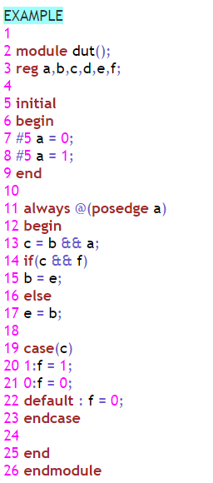
Code Coverage: Statement coverage
There are total 12 statements at lines
5, 7, 8, 11, 13, 14, 15, 17, 19, 20, 21, 22 Covered 9 statements: 5, 7, 8, 11, 13, 14, 17, 19, 21 Uncovered 3 statements: 15, 20, 22 Statement coverage percentage: 75.00 (9/12)

Slide 6
Code Coverage: Conditional coverage
Conditional coverage is the ratio of no. of cases checked to the total no. of cases present.
Suppose one expression having Boolean expression like AND or OR, so entries which is given to that expression to the total possibilities is called expression coverage.

Slide 7
Code Coverage: Conditional coverage
At LINE 13: Combinations of STATEMENT c = (b && a)
B = 0 and a = 0 is Covered
B = 0 and a = 1 is Covered
B = 1 and a = 0 is Not Covered
b = 1 and a = 1 is Not Covered
At LINE 14: combinations of STATEMENT if ((c && f))
C = 0 and f = 0 is Covered
C = 0 and f = 1 is Not Covered
C = 1 and f = 0 is Not Covered
C = 1 and f = 1 is Not Covered
Total possible combinations: 8
Total combinations executed: 3

Slide 8
Code Coverage: Branch coverage
At line 15 branch b = e; not covered
At line 17 branch e = b; covered
At line 20 branch 1: f = 1; not covered
At line 21 branch 0: f = 0; covered
At line 22 branch default: f = 0; not covered
Coverage percentage: 40.00 (2/5)

Slide 9
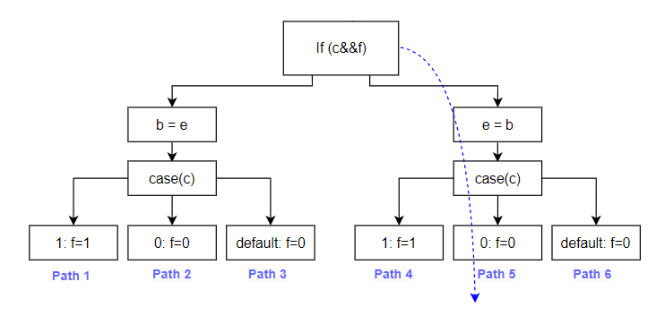
Code Coverage: Path coverage
Path 1 : Not Covered
Path 2 : Not Covered
Path 3: Not Covered
Path 4: Not Covered
Path 5 : Covered
Path 6 : Not Covered
Total possible paths : 6
Total covered path : 1
Path coverage Percentage : 16.67 (1/6)

Slide 10
Code Coverage: Toggle coverage
Name Toggled 1->0 0->1
a No Yes
b No No
c No No
d No No
e No No
f No No

Slide 11
Code Coverage: FSM coverage
In this coverage we look for how many times states are visited, transited and how many sequence are covered in a Finite state machine.
Two Types:
1. State Coverage:
It gives the coverage of no. of states visited over the total no. of states.
2. Transition Coverage:
It will count the no. of transition from one state to another and it will compare it with other total no. of transition.

Slide 12
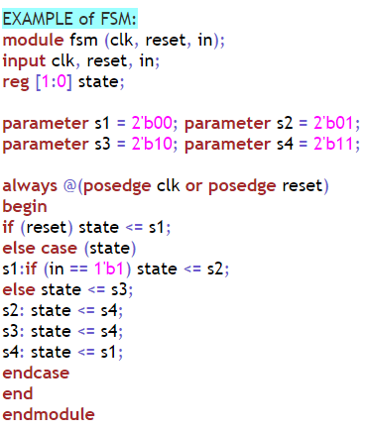
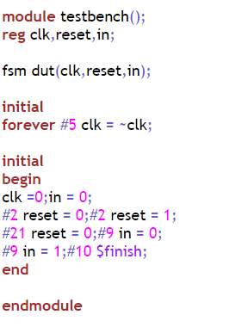
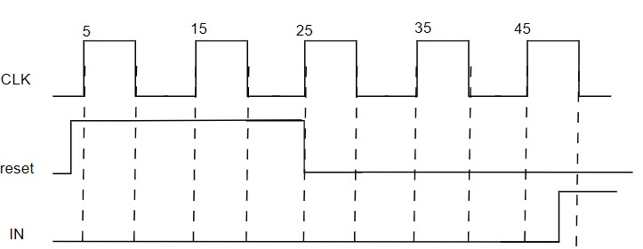
Code Coverage: FSM coverage

Slide 13
Code Coverage: FSM coverage
FSM coverage report for the above example:
// state coverage
s1 | Covered
s2 | Not Covered
s3 | Covered
s4 | Covered
// state transition
s1->s2 | Not Covered s3->s1 | Not Covered
s1->s3 | Covered s3->s4 | Covered
s2->s1 | Not Covered s4->s1 | Covered
s2->s4 | Not Covered
@4 S1
@5 S1
@15 S1
@25 S3
@35 S4
@45 S1

Slide 14
Code Coverage: Summary
Achieving high code coverage does not guarantee the correctness of the design or the absence of bugs.
It is possible to have high code coverage but still have functional bugs that were not exercised during testing.
In addition, code coverage does not take into account the design's corner cases and error handling.

Slide 15
Functional Coverage
There are two types of functional coverage:
1. Cover property
Checks whether sequences of behaviors have occurred.
Using SystemVerilog Assertions.
2. Covergroup
Checks combinations of data values have occurred. We can get Data- oriented coverage by writing Coverage groups, coverage points and also by cross coverage

Slide 16
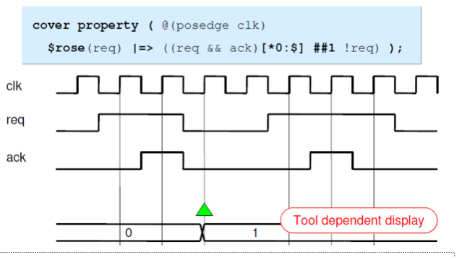
Functional Coverage: Cover property

Slide 17
Functional Coverage: Covergroup
The covergroup construct is a user-defined type. The type definition is written once, and multiple instances of that type can be created in different contexts.
A covergroup instance can be created via the new() method.
A covergroup can be defined in a module, program, interface, or class.
Each covergroup specification can include the following components:
Clocking event
Coverage points
Cross coverage
Arguments(optional)
Coverage Options

Slide 18
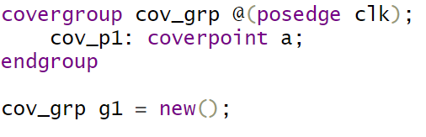
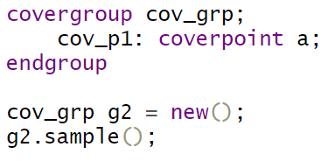
Covergroup: Clocking event
A clocking event that synchronizes the sampling of coverage points

Slide 19
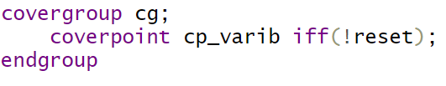
Covergroup: Clocking event
The expression within the iff construct specifies an optional condition that disables coverage for that cover point.
In the preceding example, cover point "cp_varib" is covered only if the value reset is low.

Slide 20
Functional Coverage: Coverage Points
Each coverage point is associated with “bin”. On each sample clock simulator will increment the associated bin value.
Bins can be created implicitly or explicitly
Implicit Bins
- While define cover point, if you do not specify any bins, then Implicit bins are created.
- For an “n” bit integral coverpoint variable, a 2^n number of automatic bins will get created.
- The number of bins creating can be controlled by auto_bin_max parameter.

Slide 21
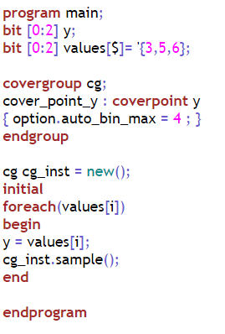
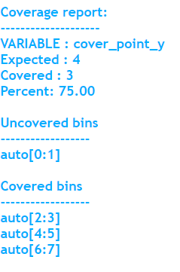
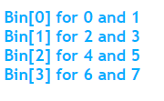
Coverage Points: Implicit Bins

Slide 22
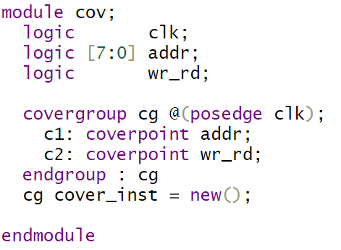
Coverage Points: Implicit Bins
for addr: c1.auto[0] c1.auto[1] c1.auto[2] … c1.auto[255]
for wr_rd: c2.auto[0]

Slide 23
Coverage Points: Explicit Bins
Explicit bin creation is recommended method.
Not all values are interesting or relevant in a cover point, so when the user knows the exact values he is going to cover, he can use explicit bins.
You can also name the bins.
“bins” keyword is used to declare the bins explicitly to a variable.
Two types:
1. Value Bins
2. Transition Bins

Slide 24
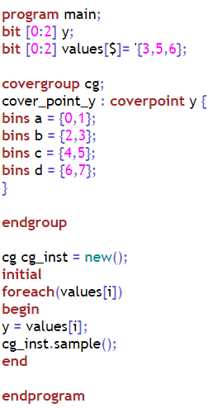

Coverage Points: Explicit Bins

Slide 25
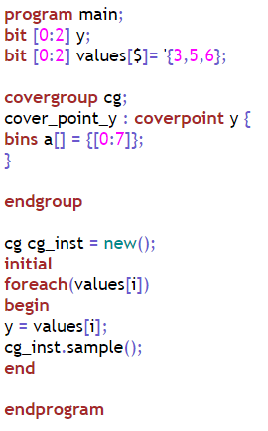
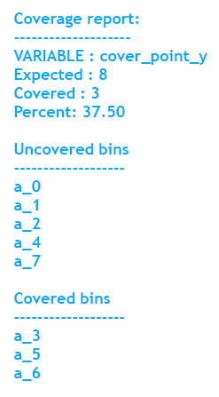
Coverage Points: Explicit Bins
Array of Bins

Slide 26
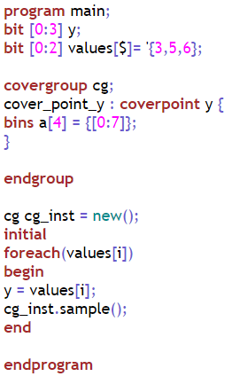
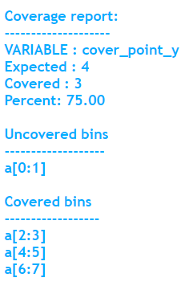
Coverage Points: Explicit Bins
Fixed number of bins

Slide 27
Coverage Points: Explicit Bins
SystemVerilog allows specifying one or more sets of ordered value transitions of the coverage point.
Type of Transitions:
Single Value Transition
Sequence Of Transitions
Set Of Transitions
Consecutive Repetitions
Range Of Repetition
Goto Repetition
Non Consecutive Repetition

Slide 28
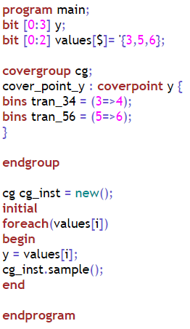

Coverage Points: Explicit Bins
Single Value Transition

Slide 29
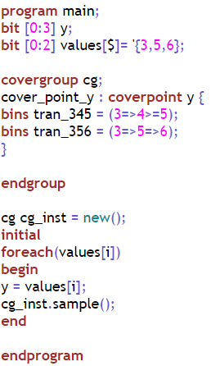

Coverage Points: Explicit Bins
Sequence Of Transitions

Slide 30
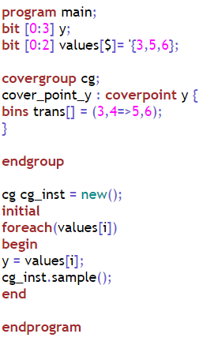
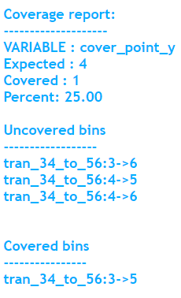
Coverage Points: Explicit Bins
Set Of Transitions

Slide 31
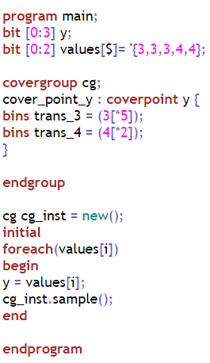
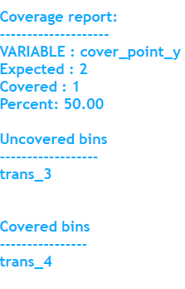
Coverage Points: Explicit Bins
Consecutive Repetitions

Slide 32
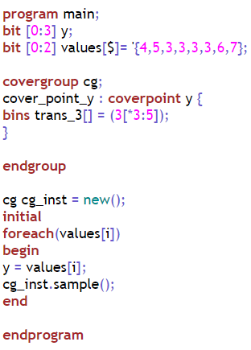

Coverage Points: Explicit Bins
Range Of Repetition

Slide 33
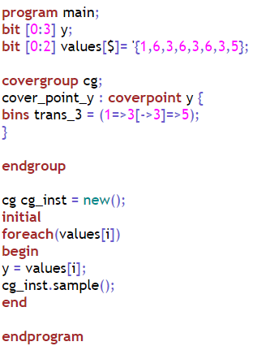
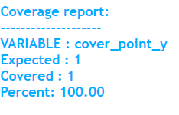
Coverage Points: Explicit Bins
Goto Repetition

Slide 34
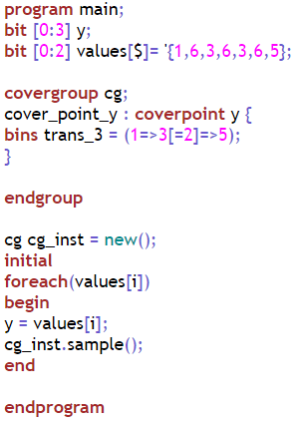
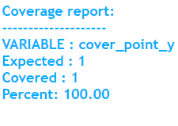
Coverage Points: Explicit Bins
Non Consecutive Repetition

Slide 35
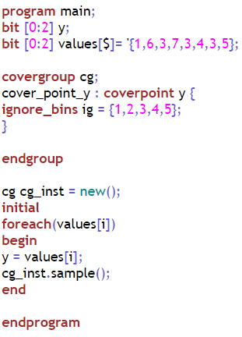
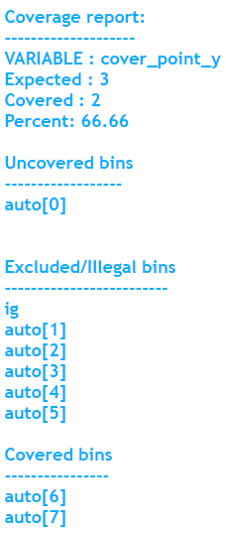
Coverage Points: Explicit Bins
Ignore Bins

Slide 36
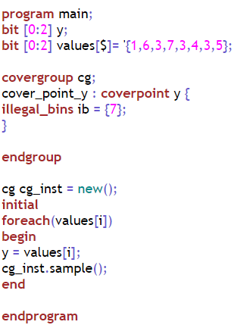

Coverage Points: Explicit Bins
Illegal Bins:

Slide 37
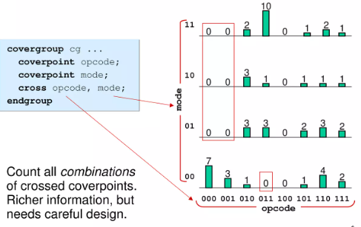
Functional Coverage: Cross Coverage
Cross allows keeping track of information which is received simultaneous on more than one cover point.
Measures what values were seen for two or more cover points at the same time.
Note that when you measure cross coverage of a variable with N values, and of another with M values, SystemVerilog needs N*M cross bins to store all the combinations.

Slide 38
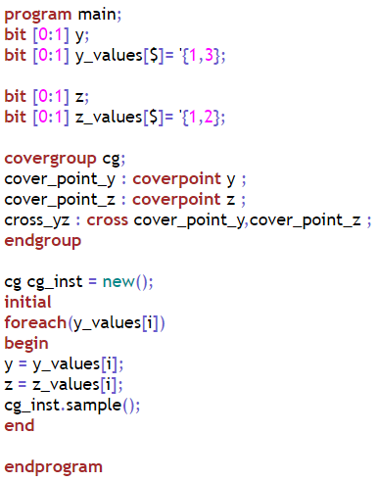
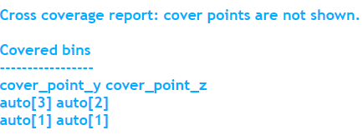
Functional Coverage: Cross Coverage

Slide 39
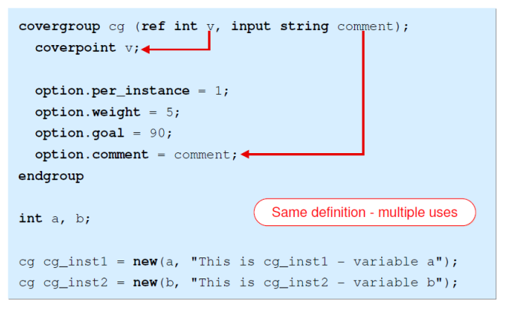
Functional Coverage: Arguments
Generic coverage groups can be written by passing their traits as arguments to the coverage constructor. This allows creating a reusable coverage group which can be used in multiple places.

Slide 40
Functional Coverage: Options
Coverage Options
Option | Syntax | Description | Default
Weight | weight= number | If set at the covergroup syntactic level, it specifies the weight of this covergroup instance for computing the overall instance coverage of the simulation. If set at the coverpoint syntactic level, it specifies the weight of a coverpoint for computing the instance coverage of the enclosing covergroup | 1
Goal | goal=number | Specifies the target goal for a covergroup instance. | 100
Name | name=string | Specifies a name for the covergroup instance.

Slide 41
Functional Coverage: Options
Coverage Options
Option | Syntax | Description | Default
Comment | comment=string | A comment that appears with a covergroup instance.
At_least | at_least=number | Minimum number of hits for each bin. | 1
Auto_bin_max | auto_bin_max=number | Maximum number of automatically created bins. | 64
Per_instance | per_instance=Boolean | Each instance contributes to the overall coverage information for the covergroup type. If true, coverage information considered per each instance. | 0

Slide 42
Functional Coverage: Methods
Coverage Methods
Method | Description
void sample() | Triggers sampling of the covergroup
real get_coverage() | Method returns the cumulative (or type) coverage, which considers the contribution of all instances of a particular coverage item, and it is a static method.
real get_inst_coverage() | Method returns the coverage of the specific instance on which it is invoked, thus, it can only be invoked via the "." operator.
void start() | Starts collecting coverage information
void stop() | Stops collecting coverage information

Slide 43
Coverage Reports on VCS
Home > Synopsys > Open in terminal > gedit filename.sv
Write your code and save.
In the terminal write the next commands:
Compilation command:
vcs -sverilog -cm line+cond+fsm+tgl filename.sv
Simulation Command:
./simv -cm line+cond+fsm+tgl
Command to generate Coverage report: Coverage report in html format will be in the ./urgReport directory
urg -dir simv.vdb
Open interactive Verdi to track coverage
Verdi –cov –covdir simv.vdb &

Slide 44
Assignment
Your task is to design a testbench for a given RTL (Register Transfer Level) code of a finite state machine and create a set of cover groups. The goal is to cover the states, state transitions, and output signals of the finite state machine.

